Slide 1
Kinetic Molecular Theory
Ch. 14

Slide 2
The Nature of Gases
Gas particles can be monatomic (Ne), diatomic (N₂), or polyatomic (CH₄) – but they all have these characteristics in common:
1) Gases have mass.
2) Gases are compressible.
3) Gases fill their containers.
4) Gases diffuse
5) Gases exert pressure.
.

Slide 3
Kinetic Molecular Theory
There is a theory that modern day chemist’s use to explain the behaviors and characteristics of gases - the Kinetic Molecular Theory of Matter.
The word kinetic refers to motion.
The word molecular refers to molecules

Slide 4
Kinetic Molecular Theory
The theory states that the tiny particles in all forms of matter in all forms of matter are in constant motion.

Slide 5
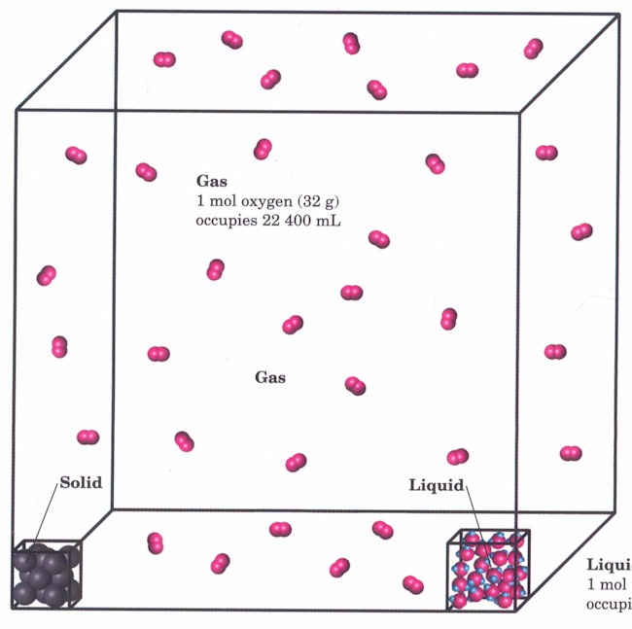

Slide 6
KMT
A gas is composed of small hard particles.
The particles have an insignificant volume and are relatively far apart from one another.
There is empty space between particles.
No attractive or repulsive forces between particles.

Slide 7
KMT
The particles in a gas move in constant random motion.
Particles move in straight paths and are completely independent of each of other
Particles path is only changed by colliding with another particle or the sides of its container.

Slide 8
KMT
All collisions a gas particle undergoes are perfectly elastic.
No energy is lost from one particle to another, and the total kinetic energy remains constant.

