Slide 1
Murder in the laboratory

Slide 2
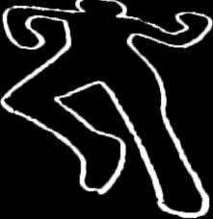
The crime scene
Mr. Boddy, a beloved Chemistry teacher, was found dead on the floor of the lab. As police investigated the scene, they found a clear liquid pooled around his lifeless face. Police quickly guessed that the clear liquid must be the murder weapon. There are signs of a struggle. The murder must have forced Mr. Boddy to ingest the chemical because Mr. Boddy would have NEVER done so willingly.
Mystery Solution

Slide 3
The Suspects

Slide 4
Professor plum
Professor Plum is an eccentric chemistry teacher that was working in the study with sodium hydroxide solutions of molarities near 0.10 M. Mr. Boddy seemed to always clash with Plum and his work. He was often responsible for broken glassware and rarely cleaned up after his experiments.

Slide 5
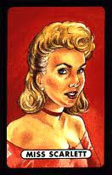
Miss Scarlett
Miss Scarlett never liked Mr. Boddy. She always thought she could have done a better job, and was immensely jealous of the adoration of the students. As a student teacher, Miss Scarlett would have had access to the chemistry closet, and was found to have calcium chloride with a molarity of 0.05 M.

Slide 6
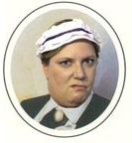
Ms. white
Ms. White is an asthmatic. Consequently, she has a prescription for potassium iodide that she claims was in her bathroom at the time of the murder. Her pharmacist assured the police that her potassium iodide solution has a molarity of 0.10 M.
Ms. White was a janitor and there is a long record of complaints she made about Mr. Boddy’s messy classroom habits.

Slide 7
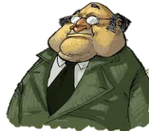
Mr. Green
Mr. Green is a photographer. As a photographer, he uses solutions of strontium nitrate 0.10 M in the darkroom. Mr. Green apparently had been caught red-handed at his own blackmail game. Police found compromising pictures of Mr. Green and Miss Scarlet hidden in Mr. Boddy’s bedroom. Mrs. Green should be spared seeing the pictures if at all possible.

Slide 8
Doctor Blue
Doctor Blue is a new addition to the staff, who sometimes goes by John Smith. The Doctor, in addition to enjoying asking questions which showcase how clever he is, has a strange fascination with a chemical he calls Krillitane Oil. According to the labels on his barrels, Krillitane Oil is 0.05 M NaOH.

Slide 9
Mrs. Peacock
Mrs. Peacock is quite the animal lover and works in a stable. She was found in the stable administering potassium iodide solution to her horse. When questioned, she admitted that her horse had a severe case of bronchitis. Her veterinarian informed detectives that the strength of the solution was 0.05 M. Mr. Boody and Mrs. Peacock had been lab partners in Professor Plum's chemistry class when they were students together. Professor Plum recalled how angry Mrs. Peacock would get when Mr. Boddy came late to class,
unprepared for the experiments, and how
Mr. Boddy invariably got sick a few days
before lab reports were due.

Slide 10
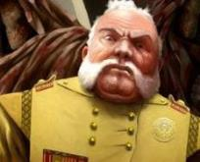
Colonel mustard
Colonel Mustard is a retired Army Colonel and amateur chemist. Missing his army days, he possessed strontium nitrate solutions of 0.05 M, in the conservatory which he used for making low grade explosives. The Colonel, who despised Mr. Boddy’s left wing politics, was tired of Mr. Boddy’s persistent attempts to ban private possession of explosives within city limits. Needless to say, the Colonel’s
wry smirk during the police interrogation
raised their suspicions.

Slide 11
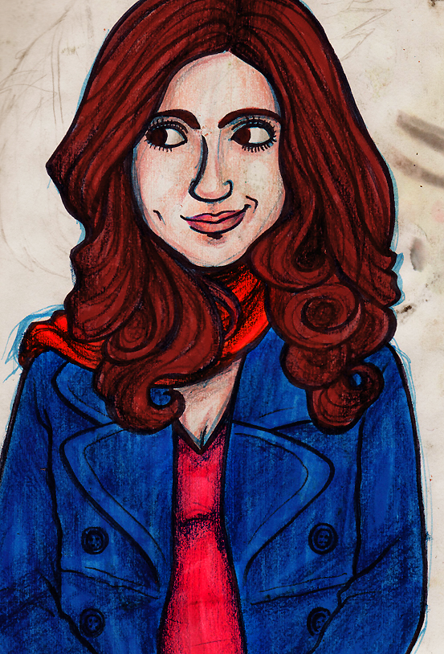
Tammy Tangerine
Tammy is an artist, and is known to use 0.10 M calcium chloride solution as a deinking agent in the recycled paper she makes as part of her unique work. It has long been known that she had feelings for Mr. Boddy which were never returned.

Slide 12
DRIVING QUESTION
How can we use chemistry to solve a murder?

Slide 13
Know Need to Know

Slide 14
Police Report
News Broadcast

Slide 15
Fill out the team contract.
Raise your hand when you are ready for me to collect it.
Discuss what are some things we could do determine what unknown chemical the murder weapon was.

Slide 16
Murder Weapon Lab

