Slide 1
Bellwork:
Come get a homework packet.
Find your seat. Begin to read the team contract.
Get out a sheet of paper to take notes on
(Unit 11 Solutions).

Slide 2
Unit 11 Solutions
Chapter 15 Section 3
Chapter 16

Slide 3
Solutions
Homogeneous mixtures
Solvent = dissolving medium
  often liquid; frequently water
  gas in air and other gas solutions
  rarely a solid
Solute(s) = dissolved material(s)
  solids, liquids, and/or gases
  often more than one solute

Slide 4
The solute is(are) the substance(s) present in the smaller amount(s)
The solvent is the substance present in the larger amount

Slide 5
“like dissolves like”
Two substances with similar intermolecular forces are likely to be soluble in each other.
non-polar molecules are soluble in non-polar solvents
    CCl₄ in C₆H₆
polar molecules are soluble in polar solvents
    C₂H₅OH in H₂O
ionic compounds are more soluble in polar solvents
    NaCl in H₂O or NH₃ (l)

Slide 6
Simulations
Solvation- the process by which the positive and negative ions of an ionic solid become surrounded by the solvent molecules.

Slide 7
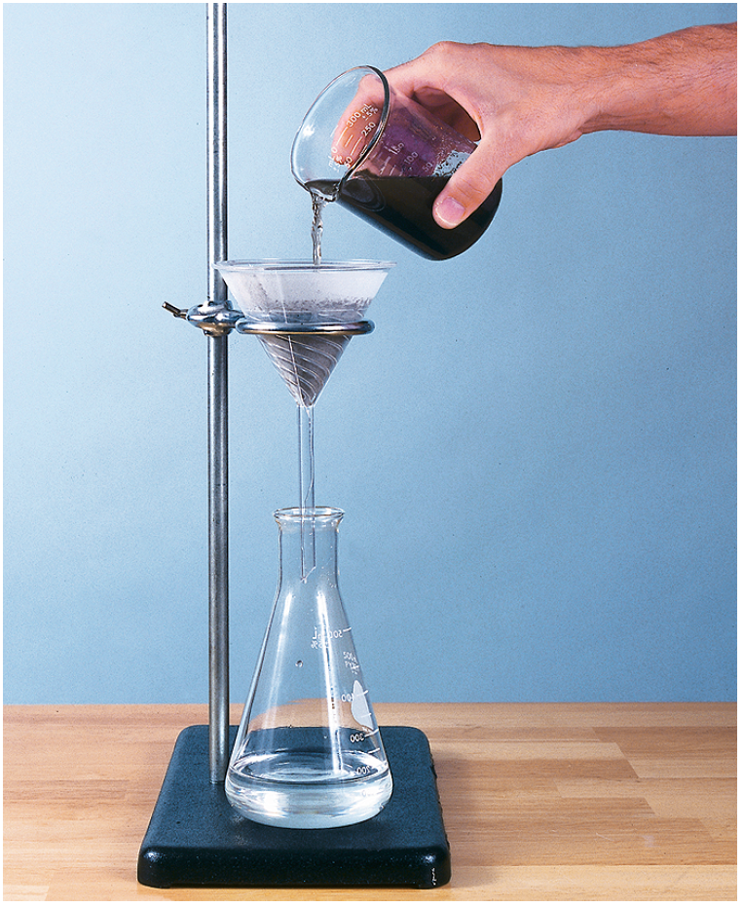
Suspensions
    A suspension is a mixture from which particles settle out upon standing.
      A suspension differs from a solution because the particles of a suspension are much larger and do not stay suspended indefinitely.

Slide 8
Solutions vs Colloids
Solution
  Solute particle are of ionic or molecular size (a few nm across)
  Transparent to ordinary light
  Stable unless solvent evaporated
Colloids
  Solute (called “dispersed phase”) typically -1 nm to 1000 nm
  Giant molecules (or “clumps” of smaller ones)
  Not totally transparent – Tyndall Effect
  Dispersed phase may separate out (similar to separation of mayonnaise).

Slide 9
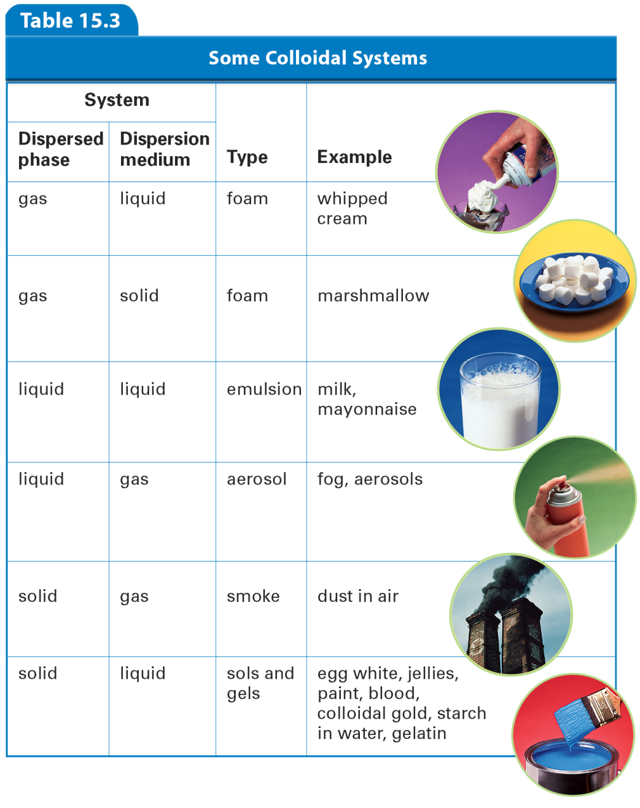
Colloids
p.460

Slide 10

Colloids
  The Tyndall Effect
    The scattering of visible light by colloidal particles is called the Tyndall effect.
Notes:
The path of light is visible only when the light is scattered by particles. a) Fog or mist is a colloid and thus exhibits the Tyndall effect. b) Particles in colloids and suspensions reflect or scatter light in all directions. Solutions do not scatter light.

Slide 11
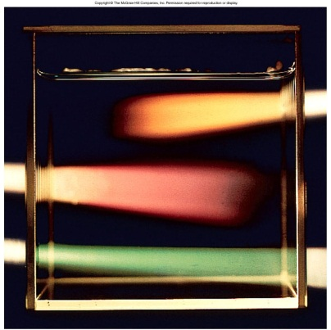

Slide 12
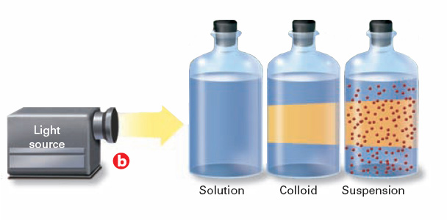
Colloids
    Particles in colloids and suspensions reflect or scatter light in all directions. Solutions do not scatter light.
Notes:
The path of light is visible only when the light is scattered by particles. a) Fog or mist is a colloid and thus exhibits the Tyndall effect. b) Particles in colloids and suspensions reflect or scatter light in all directions. Solutions do not scatter light.

Slide 13
Colloids
  Brownian Motion
      The chaotic movement of colloidal particles, which was first observed by the Scottish botanist Robert Brown (1773–1858), is called Brownian motion.
      Brownian motion is caused by collisions of the molecules of the dispersion medium with the small, dispersed colloidal particles.

Slide 14
Timed-Pair Share
A- Talk about solutions, different parts and what determines how they dissolve.
B- talk about colloids, their properties and types

Slide 15
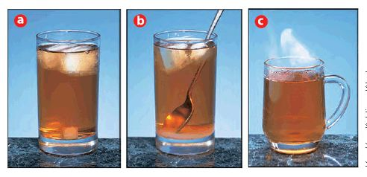
Solution Formation
    The compositions of the solvent and the solute determine whether a substance will dissolve. The factors that determine how fast a substance dissolves are
        stirring (agitation)
        temperature
        the surface area of the dissolving particles

Slide 16
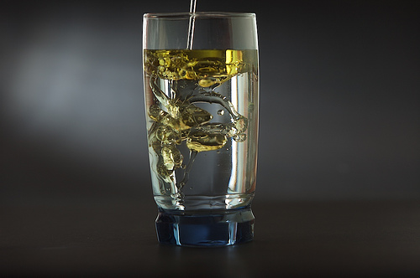
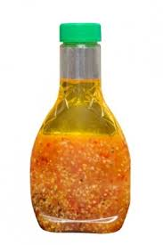
Factors Affecting Solubility
Nature of Solute / Solvent. - Like dissolves like

Slide 17
Miscible vs. Immiscible
Miscible- two liquids that dissolve in each other in all proportions
Immiscible- two liquids that are insoluble in one another

Slide 18
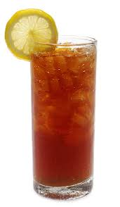
Factors Affecting Solubility
Nature of Solute / Solvent.
2. Temperature -
Solids/Liquids- Solubility increases with temperature
Increase K.E. increases motion and collision between solute / solvent.

Slide 19
Factors Affecting Solubility
Nature of Solute / Solvent.
2. Temperature -
Gas - Solubility decreases with Temperature
Increase K.E. result in gas escaping to atmosphere.

Slide 20
A saturated solution contains the maximum amount of a solute that will dissolve in a given solvent at a specific temperature.
An unsaturated solution contains less solute than the solvent has the capacity to dissolve at a specific temperature.
A supersaturated solution contains more solute than is present in a saturated solution at a specific temperature.

Slide 21
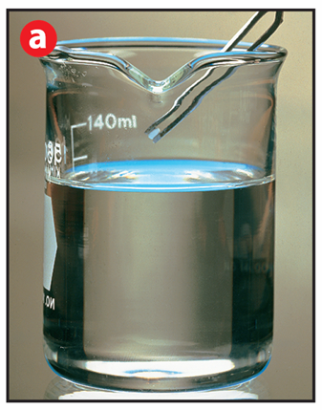
    A supersaturated solution is clear before a seed crystal is added.
Notes:
A supersaturated solution crystallizes rapidly when disturbed. a) The solution is clear before a seed crystal is added. b) Crystals begin to form in the solution immediately after the addition of a seed crystal. c) Excess solute crystallizes rapidly. Applying Concepts When the crystallization has ceased, will the solution be saturated or unsaturated?

Slide 22
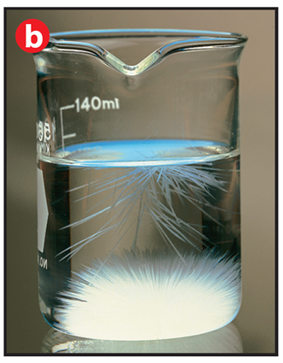
    Crystals begin to form in the solution immediately after the addition of a seed crystal.
Notes:
A supersaturated solution crystallizes rapidly when disturbed. a) The solution is clear before a seed crystal is added. b) Crystals begin to form in the solution immediately after the addition of a seed crystal. c) Excess solute crystallizes rapidly. Applying Concepts When the crystallization has ceased, will the solution be saturated or unsaturated?

Slide 23
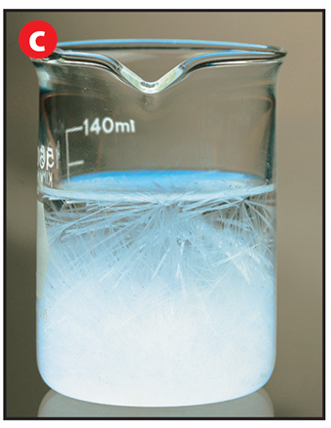
    Excess solute crystallizes rapidly.
Notes:
A supersaturated solution crystallizes rapidly when disturbed. a) The solution is clear before a seed crystal is added. b) Crystals begin to form in the solution immediately after the addition of a seed crystal. c) Excess solute crystallizes rapidly. Applying Concepts When the crystallization has ceased, will the solution be saturated or unsaturated?

Slide 24
Timed –Pair Share
A- Discuss factors that affect solubility
B- Discuss different Types of solution

Slide 25

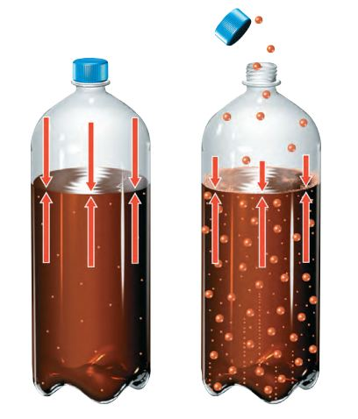
Henry’s Law
Henry’s Law states that at a given temperature, the solubility (S) of a gas in a liquid is directly proportional to the pressure (P) of the gas above the liquid.

Slide 26
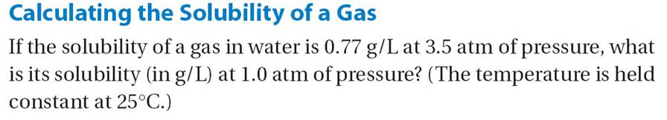

Slide 27
Contracts if time.

